Slide 1
Building a Spam Classifier

Slide 2
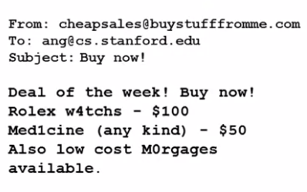
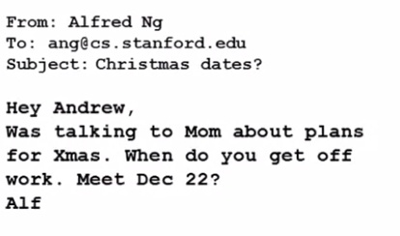
Prioritizing What To Work On
“Spam” words
Spam Email
Non-Spam Email

Slide 3
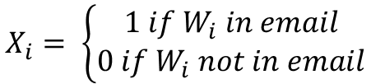
Prioritizing What To Work On
Building a Spam Classifier
Supervised Learning, x = features of email, y = spam (1) or not spam (0)
Features x: Choose 100 words indicative of spam/non spam
In practice, take most frequently occuring n words (10000 to 50000)
Buy
Deal
Discount
Now
Offer
Sale
…
0
1
1
0
1
1
…
W =
X =
$$X_{i}= \left\{\begin{aligned}1 if W_{i} in email \\ 0 if W_{i} not in email\end{aligned}\right.$$

Slide 4
Prioritizing What To Work On
Improving Model
Collect lots of data
Develop features based on email routing
Devolop features for message body
Detect misspellings.

Slide 5
Using Large Data Sets

Slide 6
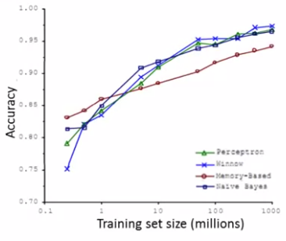
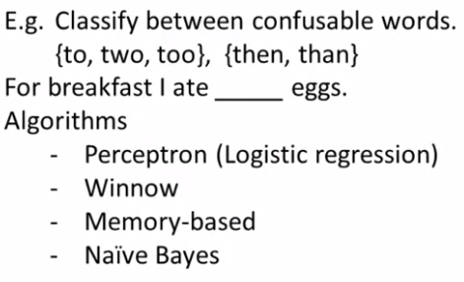
Data For Machine Learning
Design a high accuracy learning system
More Data -> Better Performance

Slide 7
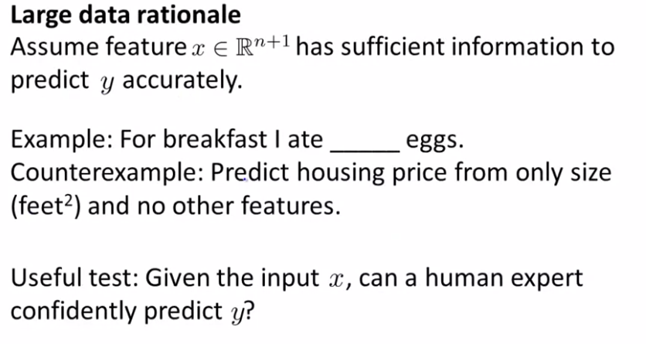
Data for Machine Learning
Human expert can confidently predict missing word => Feature x may predict y correctly
two
Human expert cannot predict accurately using only size => Need more features

Slide 8
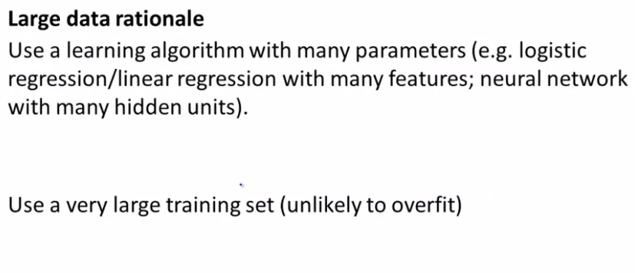
Data for Machine Learning

